Slide 1
Building Java Programs Chapter 3
Parameters and Objects

Slide 2
Declaring a parameter
Stating that a method requires a parameter in order to run
public static void name ( type name ) {
statement(s);
}
Example:
public static void sayPassword(int code) {
System.out.println("The password is: " + code);
}
When sayPassword is called, the caller must specify the integer code to print.

Slide 3
Passing a parameter
Calling a method and specifying values for its parameters
name (expression);
Example:
public static void main(String[] args) {
sayPassword(42);
sayPassword(12345);
}
Output:
The password is 42
The password is 12345

Slide 4
Parameters and loops
A parameter can guide the number of repetitions of a loop.
public static void main(String[] args) {
chant(3);
}
public static void chant(int times) {
for (int i = 1; i <= times; i++) {
System.out.println("Just a salad...");
}
}
Output:
Just a salad...
Just a salad...
Just a salad...

Slide 5
How parameters are passed
When the method is called:
The value is stored into the parameter variable.
The method's code executes using that value.
public static void main(String[] args) {
chant(3);
chant(7);
}
public static void chant(int times) {
for (int i = 1; i <= times; i++) {
System.out.println("Just a salad...");
}
}
3
7

Slide 6
Common errors
If a method accepts a parameter, it is illegal to call it without passing any value for that parameter.
chant(); // ERROR: parameter value required
The value passed to a method must be of the correct type.
chant(3.7); // ERROR: must be of type int

Slide 7
Multiple parameters
A method can accept multiple parameters. (separate by , )
When calling it, you must pass values for each parameter.
Declaration:
public static void name (type name, ..., type name) {
statement(s);
}
Call:
methodName (value, value, ..., value);

Slide 8
Multiple params example
public static void main(String[] args) {
printNumber(4, 9);
printNumber(17, 6);
printNumber(8, 0);
printNumber(0, 8);
}
public static void printNumber(int number, int count) {
for (int i = 1; i <= count; i++) {
System.out.print(number);
}
System.out.println();
}
Output:
444444444
171717171717
00000000

Slide 9
Value semantics
Value semantics: When primitive variables (int, double) are passed as parameters, their values are copied.
Modifying the parameter will not affect the variable passed in.
public static void strange(int x) {
x = x + 1;
System.out.println("1. x = " + x);
}
public static void main(String[] args) {
int x = 23;
strange(x);
System.out.println("2. x = " + x);
...
}
Output:
1. x = 24
2. x = 23

Slide 10
"Parameter Mystery" problem
public class ParameterMystery {
public static void main(String[] args) {
int x = 9;
int y = 2;
int z = 5;
mystery(z, y, x); // 2 and 4
mystery(y, x, z); // 9 and 3
}
public static void mystery(int x, int z, int y) {
System.out.println(z + " and " + (y - x));
}
}

Slide 11
Strings
String: A sequence of text characters.
String name = "text";
String name = expression;
Examples: String name = "Marla Singer"; int x = 3; int y = 5; String point = "(" + x + ", " + y + ")";

Slide 12
Strings as parameters
public class StringParameters {
public static void main(String[] args) {
sayHello("Marty");
String teacher = "Bictolia";
sayHello(teacher);
}
public static void sayHello(String name) {
System.out.println("Welcome, " + name);
}
}
Output:
Welcome, Marty
Welcome, Bictolia

Slide 13
Return values

Slide 14
Java's Math class
Method name | Description
Math.abs(value) | absolute value
Math.ceil(value) | rounds up
Math.floor(value) | rounds down
Math.log10(value) | logarithm, base 10
Math.max(value1, value2) | larger of two values
Math.min(value1, value2) | smaller of two values
Math.pow(base, exp) | base to the exp power
Math.random() | random double between 0 and 1
Math.round(value) | nearest whole number
Math.sqrt(value) | square root
Math.sin(value) Math.cos(value) Math.tan(value) | sine/cosine/tangent of an angle in radians
Math.toDegrees(value) Math.toRadians(value) | convert degrees to radians and back
Constant | Description
Math.E | 2.7182818...
Math.PI | 3.1415926...

Slide 15
Calling Math methods
Math.methodName(parameters)
Examples:
double squareRoot = Math.sqrt(121.0);
System.out.println(squareRoot); // 11.0
int absoluteValue = Math.abs(-50);
System.out.println(absoluteValue); // 50
System.out.println(Math.min(3, 7) + 2); // 5
The Math methods do not print to the console.
Each method produces ("returns") a numeric result.
The results are used as expressions (printed, stored, etc.).

Slide 16
Return
Return: To send out a value as the result of a method.
The opposite of a parameter:
Parameters send information in from the caller to the method.
Return values send information out from a method to its caller.
A call to the method can be used as part of an expression.
-42
Math.abs(-42)
42
main
2.71
3
Math.round(2.71)

Slide 17
Math questions
Evaluate the following expressions:
Math.abs(-1.23)
Math.pow(3, 2)
Math.pow(10, -2)
Math.sqrt(121.0) - Math.sqrt(256.0)
Math.round(Math.PI) + Math.round(Math.E)
Math.ceil(6.022) + Math.floor(15.9994)
Math.abs(Math.min(-3, -5))
Math.max and Math.min can be used to bound numbers.
Consider an int variable named age.
What statement would replace negative ages with 0?
What statement would cap the maximum age to 40?

Slide 18
Type casting
Type cast: A conversion from one type to another.
To promote an int into a double to get exact division from /
To truncate a double from a real number to an integer
Syntax:
(type) expression
Examples:
double result = (double) 19 / 5; // 3.8
int result2 = (int) result; // 3
int x = (int) Math.pow(10, 3); // 1000

Slide 19
More about type casting
Type casting has high precedence and only casts the item immediately next to it.
double x = (double) 1 + 1 / 2; // 1
double y = 1 + (double) 1 / 2; // 1.5
You can use parentheses to force evaluation order.
double average = (double) (a + b + c) / 3;
A conversion to double can be achieved in other ways.
double average = 1.0 * (a + b + c) / 3;

Slide 20
Returning a value
public static type name(parameters) {
statements;
...
return expression;
}
Example:
// Returns the slope of the line between the given points.
public static double slope(int x1, int y1, int x2, int y2) {
double dy = y2 - y1;
double dx = x2 - x1;
return dy / dx;
}
slope(1, 3, 5, 11) returns 2.0

Slide 21
Return examples
// Converts degrees Fahrenheit to Celsius.
public static double fToC(double degreesF) {
double degreesC = 5.0 / 9.0 * (degreesF - 32);
return degreesC;
}
// Computes triangle hypotenuse length given its side lengths.
public static double hypotenuse(int a, int b) {
double c = Math.sqrt(a * a + b * b);
return c;
}
You can shorten the examples by returning an expression:
public static double fToC(double degreesF) {
return 5.0 / 9.0 * (degreesF - 32);
}

Slide 22
Common error: Not storing
Many students incorrectly think that a return statement sends a variable's name back to the calling method.
public static void main(String[] args) {
slope(0, 0, 6, 3);
System.out.println("The slope is " + result); // ERROR:
} // result not defined
public static double slope(int x1, int x2, int y1, int y2) {
double dy = y2 - y1;
double dx = x2 - x1;
double result = dy / dx;
return result;
}

Slide 23
Fixing the common error
Instead, returning sends the variable's value back.
The returned value must be stored into a variable or used in an expression to be useful to the caller.
public static void main(String[] args) {
double s = slope(0, 0, 6, 3);
System.out.println("The slope is " + s);
}
public static double slope(int x1, int x2, int y1, int y2) {
double dy = y2 - y1;
double dx = x2 - x1;
double result = dy / dx;
return result;
}

Slide 24
Objects and Classes; Strings values

Slide 25
Classes and objects
Class: A program entity that represents either:
1. A program / module, or
2. A type of objects.
A class is a blueprint or template for constructing objects.
Example: The DrawingPanel class (type) is a template for creating many DrawingPanel objects (windows).
Java has 1000s of classes. Later (Ch.8) we will write our own.
Object: An entity that combines data and behavior.
object-oriented programming (OOP): Programs that perform their behavior as interactions between objects.

Slide 26
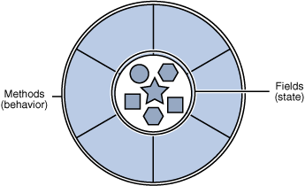
Objects
Object: An entity that contains data and behavior.
data: variables inside the object
behavior: methods inside the object
You interact with the methods; the data is hidden in the object.
Constructing (creating) an object:
Type objectName = new Type(parameters);
Calling an object's method:
objectName.methodName(parameters);

Slide 27
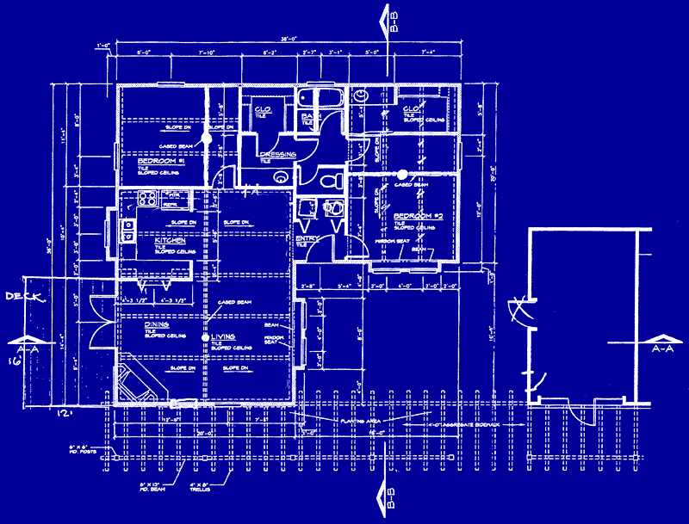
Blueprint analogy
iPod blueprint/factory
state: current song volume battery life
behavior: power on/off change station/song change volume choose random song
creates
iPod #1
state: song = "1,000,000 Miles" volume = 17 battery life = 2.5 hrs
behavior: power on/off change station/song change volume choose random song
iPod #2
state: song = "Letting You" volume = 9 battery life = 3.41 hrs
behavior: power on/off change station/song change volume choose random song
iPod #3
state: song = "Discipline" volume = 24 battery life = 1.8 hrs
behavior: power on/off change station/song change volume choose random song

Slide 28
Strings
String: An object storing a sequence of text characters.
Unlike most other objects, a String is not created with new.
String name = "text";
String name = expression;
Examples: String name = "Marla Singer"; int x = 3; int y = 5; String point = "(" + x + ", " + y + ")";

Slide 29
Indexes
Characters of a string are numbered with 0-based indexes:
String name = "R. Kelly";
First character's index : 0
Last character's index : 1 less than the string's length
The individual characters are values of type char (seen later)
index | 0 | 1 | 2 | 3 | 4 | 5 | 6 | 7
character | R | . |  | K | e | l | l | y

Slide 30
String methods
Method name | Description
indexOf(str) | index where the start of the given string appears in this string (-1 if not found)
length() | number of characters in this string
substring(index1, index2) or substring(index1) | the characters in this string from index1 (inclusive) to index2 (exclusive); if index2 is omitted, grabs till end of string
toLowerCase() | a new string with all lowercase letters
toUpperCase() | a new string with all uppercase letters
These methods are called using the dot notation:
String gangsta = "Dr. Dre";
System.out.println(gangsta.length()); // 7

Slide 31
String method examples
// index 012345678901
String s1 = "Stuart Reges";
String s2 = "Marty Stepp";
System.out.println(s1.length()); // 12
System.out.println(s1.indexOf("e")); // 8
System.out.println(s1.substring(7, 10)); // "Reg"
String s3 = s2.substring(1, 7);
System.out.println(s3.toLowerCase()); // "arty s"
Given the following string:
// index 0123456789012345678901
String book = "Building Java Programs";
How would you extract the word "Java" ?

Slide 32
Modifying strings
Methods like substring and toLowerCase build and return a new string, rather than modifying the current string.
String s = "lil bow wow";
s.toUpperCase();
System.out.println(s); // lil bow wow
To modify a variable's value, you must reassign it:
String s = "lil bow wow";
s = s.toUpperCase();
System.out.println(s); // LIL BOW WOW

Slide 33
Interactive Programs with Scanner

Slide 34
Input and System.in
Interactive program: Reads input from the console.
While the program runs, it asks the user to type input.
The input typed by the user is stored in variables in the code.
Can be tricky; users are unpredictable and misbehave.
But interactive programs have more interesting behavior.
Scanner: An object that can read input from many sources.
Communicates with System.in (the opposite of System.out)
Can also read from files (Ch. 6), web sites, databases, ...

Slide 35
Scanner syntax
The Scanner class is found in the java.util package.
import java.util.*; // so you can use Scanner
Constructing a Scanner object to read console input:
Scanner name = new Scanner(System.in);
Example:
Scanner console = new Scanner(System.in);

Slide 36
Scanner methods
Method | Description
nextInt() | reads an int from the user and returns it
nextDouble() | reads a double from the user
next() | reads a one-word String from the user
nextLine() | reads a one-line String from the user
Each method waits until the user presses Enter.
The value typed by the user is returned.
System.out.print("How old are you? "); // prompt
int age = console.nextInt();
System.out.println("You typed " + age);
prompt: A message telling the user what input to type.

Slide 37


Scanner example
import java.util.*; // so that I can use Scanner
public class UserInputExample {
public static void main(String[] args) {
Scanner console = new Scanner(System.in);
System.out.print("How old are you? ");
int age = console.nextInt();
int years = 65 - age;
System.out.println(years + " years to retirement!");
}
}
Console (user input underlined):
How old are you?
36 years until retirement!
age | 29
years | 36
29

Slide 38
Scanner example 2
import java.util.*; // so that I can use Scanner
public class ScannerMultiply {
public static void main(String[] args) {
Scanner console = new Scanner(System.in);
System.out.print("Please type two numbers: ");
int num1 = console.nextInt();
int num2 = console.nextInt();
int product = num1 * num2;
System.out.println("The product is " + product);
}
}
Output (user input underlined):
Please type two numbers: 8 6
The product is 48
The Scanner can read multiple values from one line.

